Slide 1
Proposed zoning for THE EXTRA TERRITORIAL JURISDICTION (etj)
CITY OF AUBURN INDIANA

Slide 2
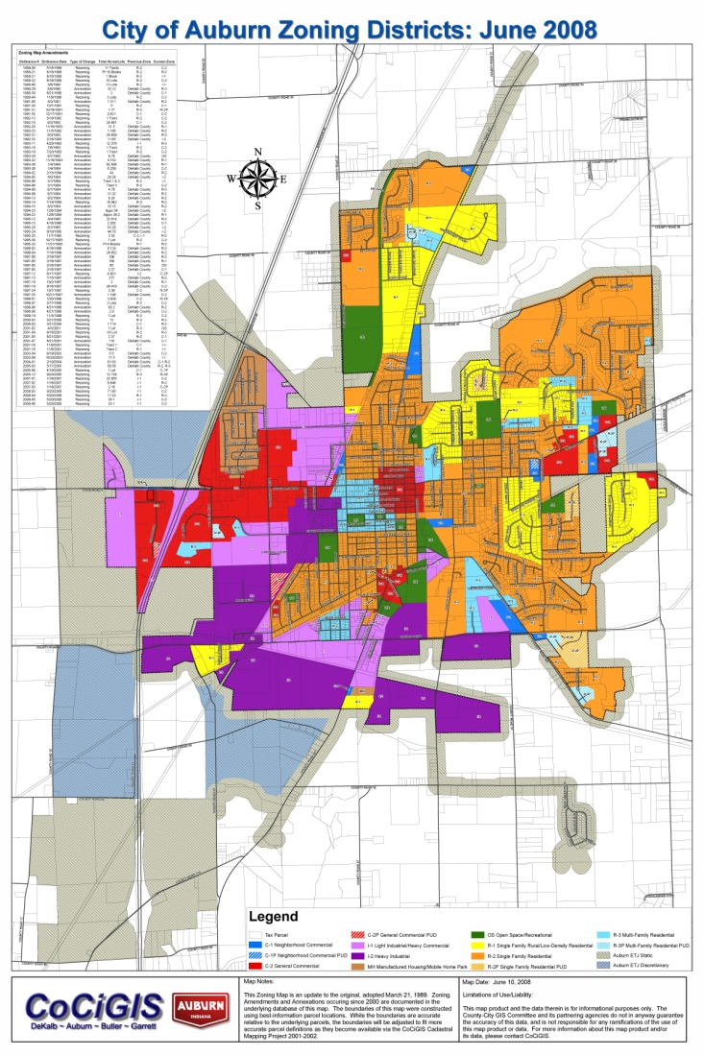
Current Zoning Map
On November 1, 2007 the Inter-local Cooperation Agreement between DeKalb County and the City of Auburn regarding Planning, Zoning, Subdivision Control, Permitting and Enforcement Jurisdiction, (aka, Extra-territorial Jurisdiction (ETJ) Areas), went into effect.
However, the Current Zoning Map had not been amended to include the ETJ area zoning classifications.
What we have is the written zoning classifications comparison table for County zoning classifications for territory taken into the Plan Commission’s jurisdiction.

Slide 3
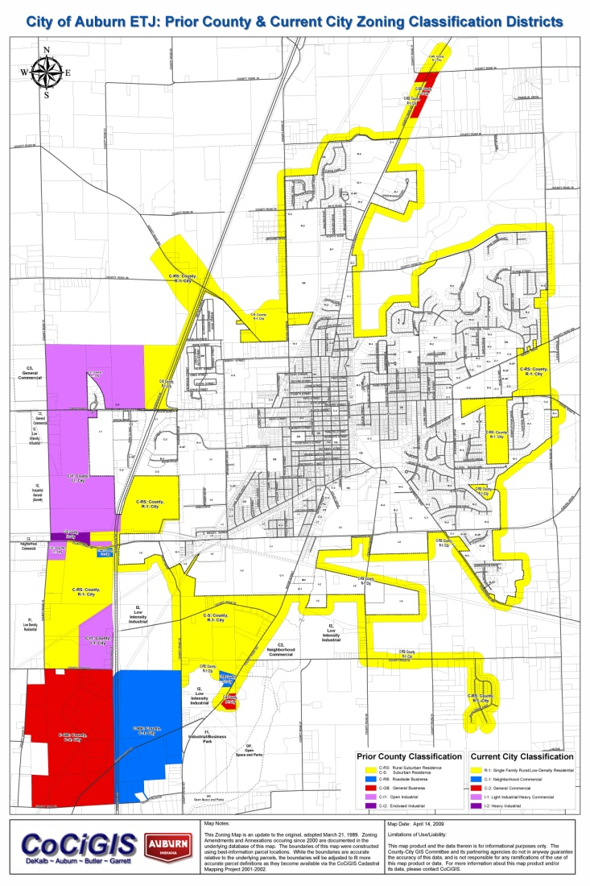
Prior County & Current City Classifications Being Applied to ETJ
Auburn District | Prior DeKalb County District
R-1 | C-RS and C-S
R-2 | C-A
R-3 | N/A
C-1 | C-LB and C-RB
C-2 | C-GB
I-1 | C-I1
I-2 | C-I2
MH | N/A
OS | N/A

Slide 4
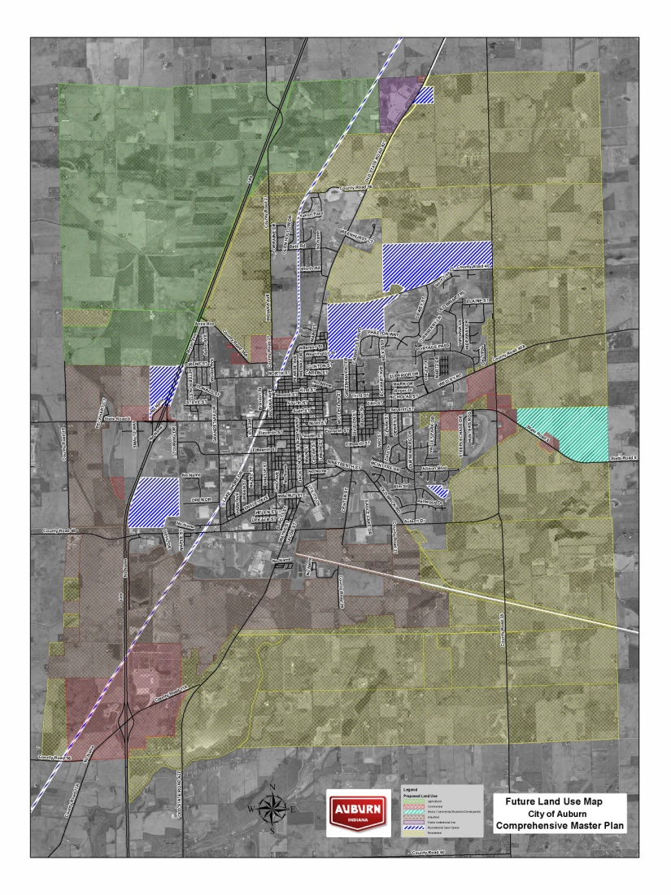
2005 Future Land Use Map
The proposed ordinance to amend the Zoning Map of the City of Auburn represents the
1. ETJ area-city designated zones,
2. Those areas proposed to be rezoned based on our guidelines of the 2005 Future Land Use Map, and
3. Recommendations of the Plan Commission.

Slide 5
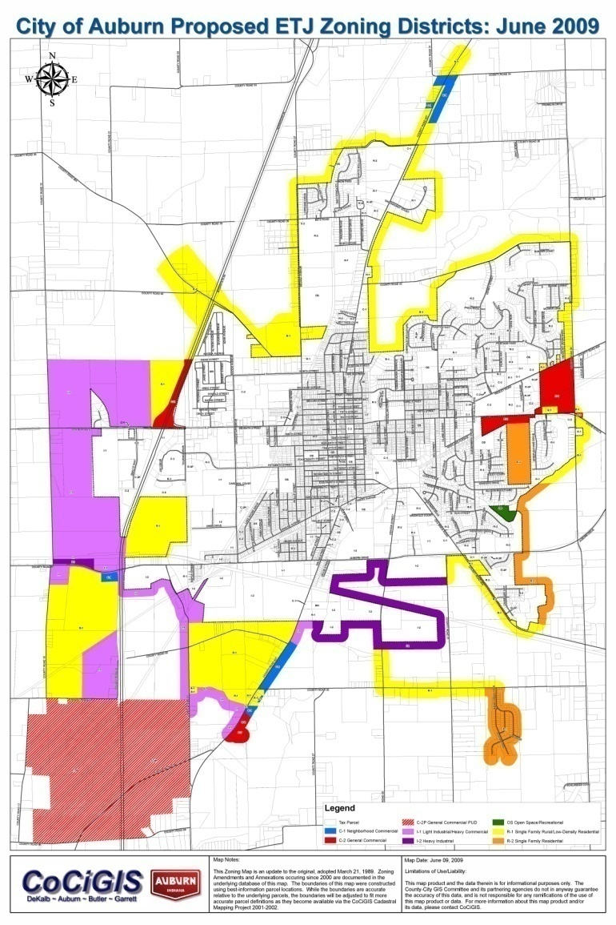
Planned Unit Development
In addition, one zoning change is proposed to be a Planned Unit Development (PUD) district for property under the control of the land owners within the Kruse Auction Park and Kruse Museum areas located on the southwest edge of the ETJ area. This zoning change was at the request of the owners.

Slide 6

Planned Unit Development
Specific PUD Conditions were presented at the Plan Commission meeting in February 2009 based on discussions that took place in October 2008 with the owners and the Plan Commission. The conditions were applied to the Plan Unit Development that is identified as a General Commercial PUD/C-2P. This C-2P district was then placed on the proposed amended zoning map that was presented to the Plan Commission at the March, April, and May 2009 meetings.

Slide 7
Proposed Amended Zoning Map
The proposed amended zoning map being presented to the City Common Council was reviewed by the Plan Commission at three meetings (March, April, and May 2009) and approved by the Plan Commission at its May 2009 meeting with their recommendation for adoption by the City Common Council.

